Slide 1
PennyWise - Personal Budgeting and Finance Application
https://pennywise-ui-2c247d5cd417.herokuapp.com/
Iteration 3 - Team #1: Brian Fenstermacher, Jisoo Lee, Sherif Zeyada, Mali Rivera, Clyde Yeung, Chaitanya Saraogi, Sean Rawson
Notes:
Chaitanya

Slide 2
Member Roles
Team leader: Brian Fenstermacher
Requirements leader: Jisoo Lee, Chaitanya Saraogi
Design and Implementation leader: Sherif Zeyada
QA leader: Mali Rivera
Configuration leader: Clyde Yeung
Security leader: Sean Rawson
Notes:
Chaitanya

Slide 3
Presentation Outline
Project Overview
Requirement Analysis
Design
Implementation
Testing
Security
Deployment
Project Management
Demo
Notes:
Chaitanya

Slide 4
Project Overview
Pennywise is a budgeting application that allows users to manage their income, and expenses and then visualize them in the form of a dashboard that presents their information in the form of a chart.
Product Features:
Account Setup
Data Visualization
Personalized User Dashboard
Expense Management
Add Expenses
Expense Categories
Income Management
Add Incomes
Income Categories
Notes:
Chaitanya
I'm thrilled to introduce you to "Pennywise," a budgeting application designed to transform the way we manage our finances. In a world filled with financial complexities, Pennywise empowers users with a simple, intuitive, and efficient solution to handle their income, expenses, and financial goals.
Our application is more than just numbers; it's about your financial well-being. Here's a glimpse of what Pennywise brings to the table:
1. Account Setup: Getting started with Pennywise is a breeze. We've simplified the setup process with google authentication to help you hit the ground running.
2. Data Visualization: We understand that numbers alone can be overwhelming. That's why Pennywise leverages data visualization techniques to convert your financial data into visually engaging charts and graphs. Your financial story is no longer hidden in spreadsheets; it's a visual masterpiece at your fingertips.
3. Personalized User Dashboard: Your financial journey is unique, and so is your Pennywise dashboard. Tailored to your needs, it provides a comprehensive view of your income, expenses, and more. It's your financial command center, beautifully designed for clarity and ease of use.
4. Expense Management: Say goodbye to budgeting headaches. Pennywise simplifies expense management with intuitive tools, allowing you to effortlessly categorize and track your spending. Add expenses on the go, and watch your budget in real-time
6. Income Management: Managing your income has never been this effortless. Pennywise supports hassle-free income management, helping you add and categorize your earnings with ease.

Slide 5
Requirements Analysis
Essential Features:
Monthly Income Tracking
Monthly Expense Tracking
User Registration and Authentication
Custom Expense Chart
Desirable Features:
Expense Categorization
Expense Tracking Visualization
Budgeting Notifications
Optional Features:
Budget Setting
Financial Tips
Financial Impact Assessment
Expense Review and Recommendations
Notes:
Chaitanya
In this team, we don't just develop features; we listen to our users. To understand the needs and preferences, we conducted a customer survey in iteration 0. This invaluable feedback has been instrumental in shaping the features and functionalities of our application. The input directly influences our ongoing development, ensuring that Pennywise is tailored to meet our customers financial requirements.
And to prioritize these needs we divided our requirements into the 3 shown Groups - Essentia (4)l, Desirable(3) and optional(4).

Slide 6
Requirements Analysis
Features-By-Iteration:
Beginning at iteration 1 since iteration 0 had no feature completions
Iteration #1:
Engine code to work with database
Build pipeline
Create Pennywise database
Iteration #2:
Create containers for different components
Engine code to retrieve inputs from UI
UI components created:
Dashboard
Setup
Navigation
AddExpense
AddIncome
Iteration #2 cont:
Create chart of spending distribution
Expense categorization
Time filterable dashboard for expenses
User budget setting
Iteration #3:
User registration
User log in / log out
Budget Notification
Notes:
Chaitanya
Now that we know what the customer wanted. The next step was to plan on how to get there. So we divided our features by Iteration as shown

Slide 7
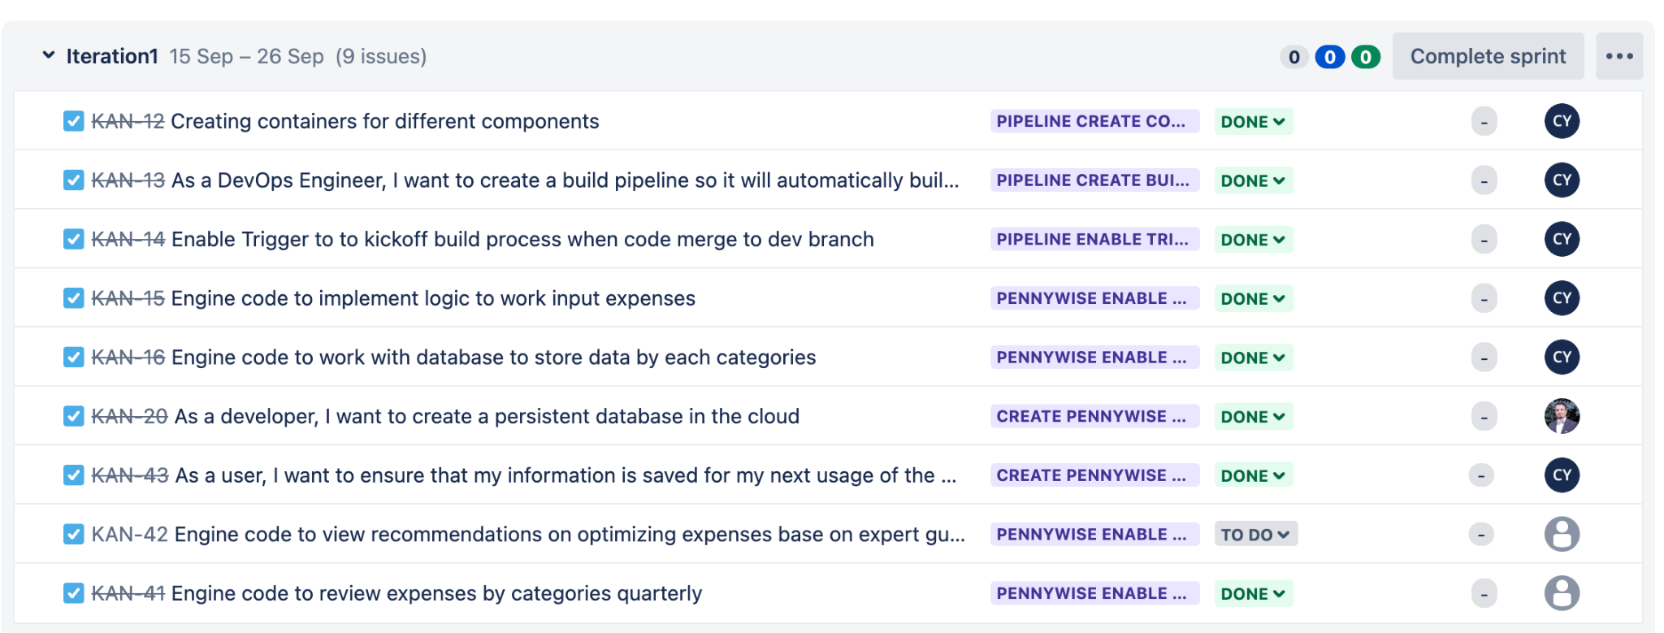
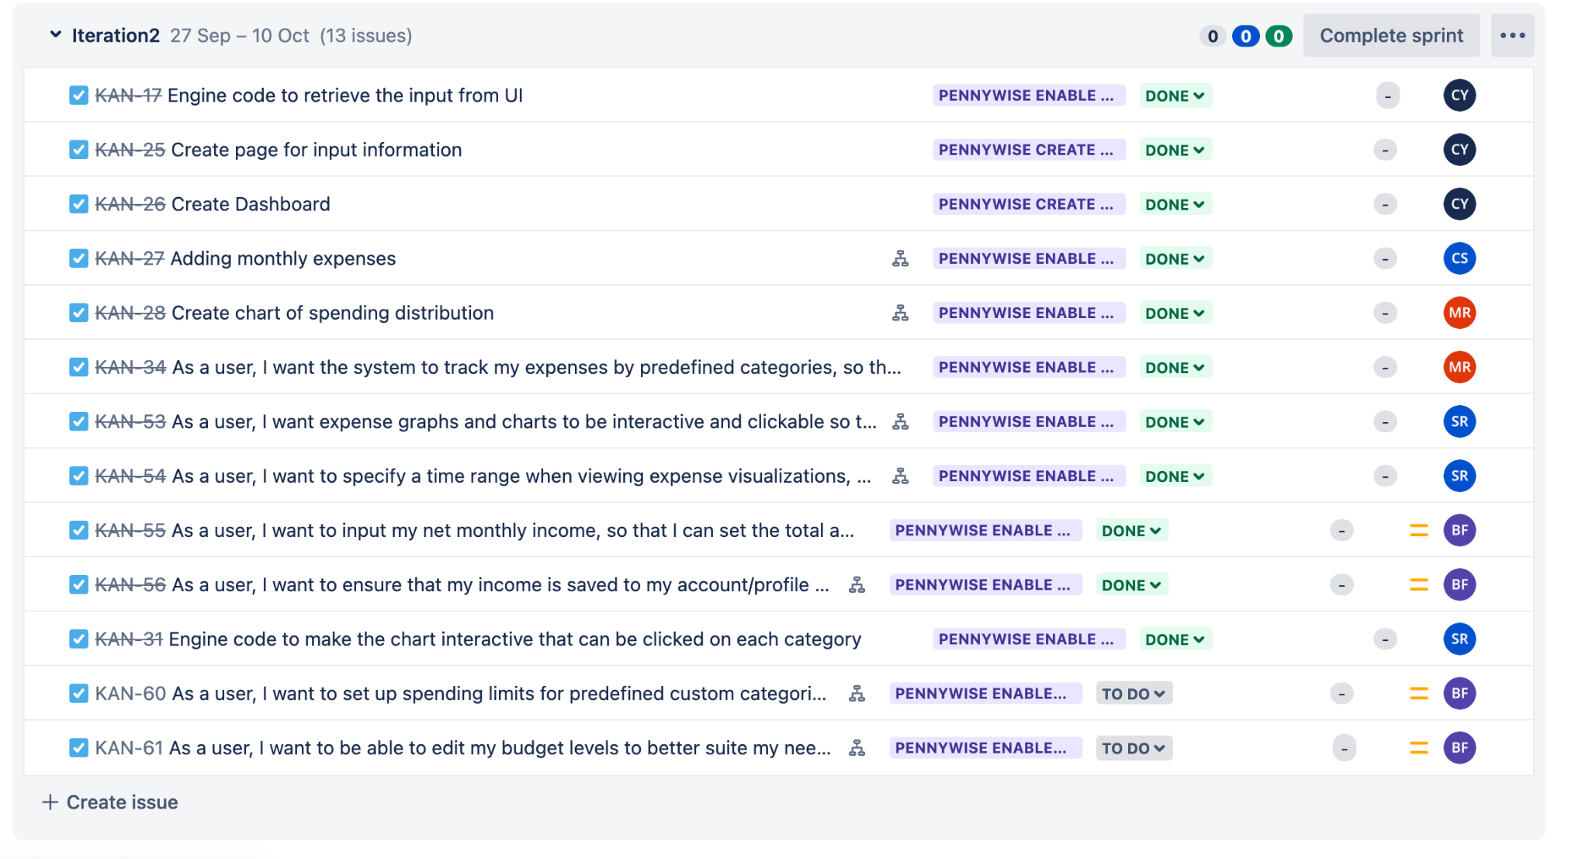
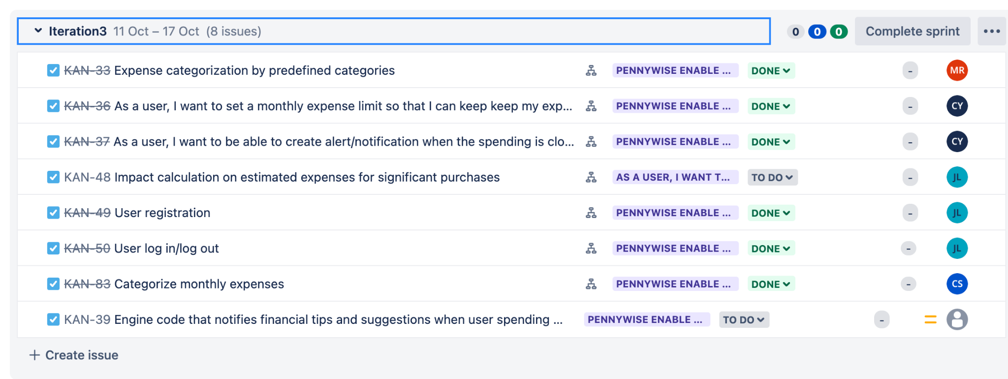
Requirements Status
Sprint Iteration1
Sprint Iteration2
Sprint Iteration3
Notes:
chaitanya
On the journey to bringing Pennywise to life, we're proud to report that we've achieved a significant milestone. We've successfully completed and implemented over 85% of all our features and a 100% of all our essential and desired features.
Essential Features: Every critical aspect of Pennywise, from monthly income and expense tracking to user registration and authentication, has been meticulously developed and fully integrated. Your financial data is secure, your income is tracked, and your expenses are under control.
Desirable Features: We've gone the extra mile to enhance your financial experience by implementing all the desirable features. From expense categorization to advanced visualization and budgeting notifications, each feature adds value to the Pennywise ecosystem.
A detailed list of completed features is available on Jira.

Slide 8
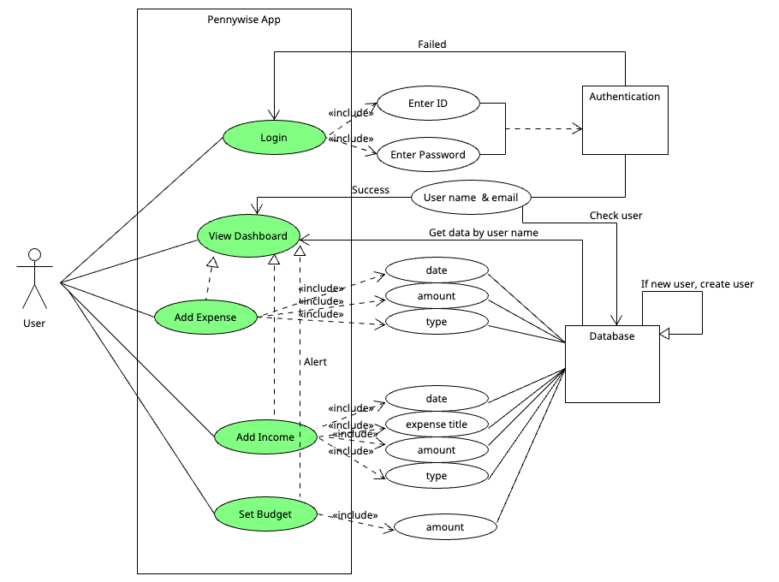
Use Case Diagram
Notes:
Jisoo

Slide 9
Design
Overview:
PennyWise is a robust application built on a client-server architecture with user-centric front-end and robust back-end. Our system is designed to be easily expanded and scalable. Each of our components will be within its container which reduces coupling and leads to future improvements. The Spring Boot back-end serves as a core in our application; it handles data processing and communication with the database.
Notes:
Sherif

Slide 10
Design Cont.
Software Architecture:
As stated in the introduction PennyWise is built on a client-server architecture. It could also be thought of as a layered architecture with three levels
React Frontend
Springboot Backend
MariaDB
UI Design:
Our plan for UI is to be straightforward and easy for our users to work with. By using a clean color palette that reflects the purpose of the product (finance/budgeting) we intend to create a platform that instills trust and security to the user. Additionally, we are choosing to utilize the Material UI framework to help build out our frontend.
Notes:
Sherif

Slide 11
Design Cont.
Business Logic // Key Algorithm:
Expense Tracking Algorithm
We will use this algorithm To provide real-time expense tracking, this algorithm continuously updates the user's remaining budget based on income, expenses, and budgeted amounts. It alerts users when they are close to exceeding their budget in a specific category.
Notes:
Sherif

Slide 12
Security Overview
Authentication:
Google Oauth
Heroku:
Management of SSL Certificates
GitHub Secrets:
Management of usernames, passwords and data strings
Notes:
Sherif
Authentication is handled by Google which removes the need for us to store user passwords and deal with them in our back end. Communication between components in Heroku has SSL handled automatically. We chose to use existing solutions for main security functionalities because they are trusted and tested. We decided it was better to do that than roll our own solution.

Slide 13
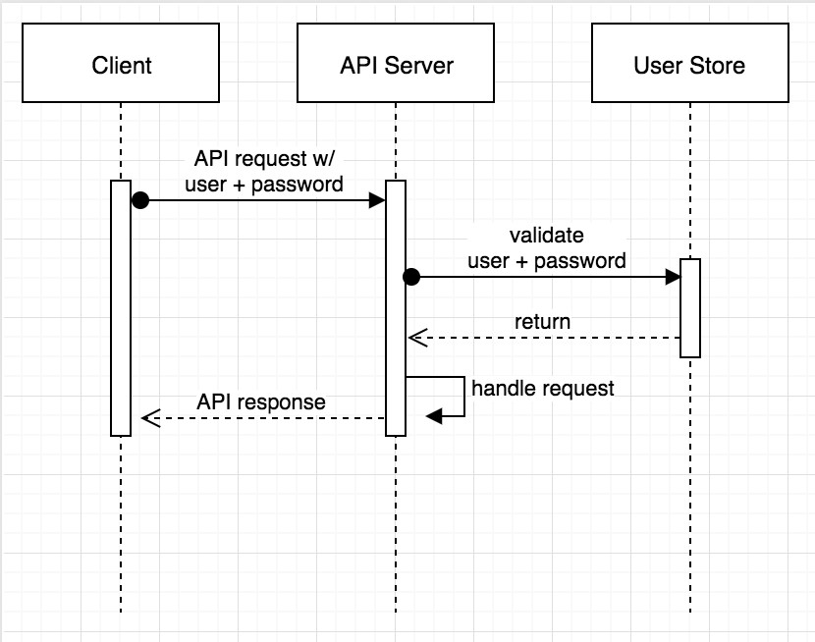
Authentication
Google Oauth2:
It provides the client applications with
Secure delegated access.
It works over HTTP and authorizes devices,API, servers, and application
with access token rather than
credentials

Slide 14
Implementation
Tools Used:
Postman
Docker
Github Actions
Heroku
Code Structure:
Frontend:
code/pennywise-ui
Backend:
code/back-end
Github Branches:
back-end
front-end
login-dev
back-end-oauth
dev
Our branches were broken out based on the work that was being done, for instance, all front end code was added to the front-end branch so that the front end team would have access to all relevant updates. Additionally, this approach allowed for minimized back-end testing errors to effect testing on the front end.
Notes:
Sean

Slide 15
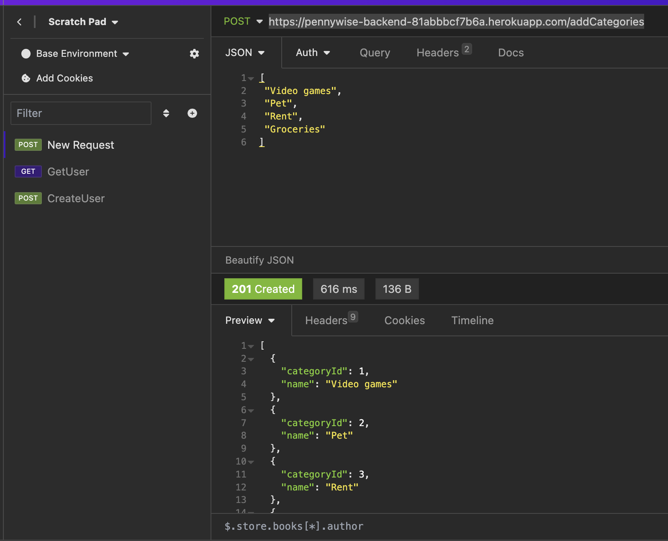
Implementation Cont.
Rest API in action:
Post:
addCategory
Notes:
Sean - The primary means of communication between the back and front end was a series of rest APIs for adding users, income, and expenses, updating users, and any other functionality needed

Slide 16



Testing
Unit Testing:
JUnit5 + Mockito Framework
Integration Testing:
Mock MVC
Acceptance Testing:
JUnit5 + Cucumber Framework
Summary:
For our project, we have written Unit and Integration tests for the back end code
Unit tests were written by the developers with JUnit5 and Mockito
Integration tests were written by the QA leader with JUnit5, Mockito, and Spring Mock MVC.
Notes:
Mali
For our project, we have written Unit and Integration tests for the back end code
Unit tests were written by the developers with JUnit5 and Mockito
Integration tests were written by the QA leader with JUnit5, Mockito, and Spring Mock MVC.

Slide 17
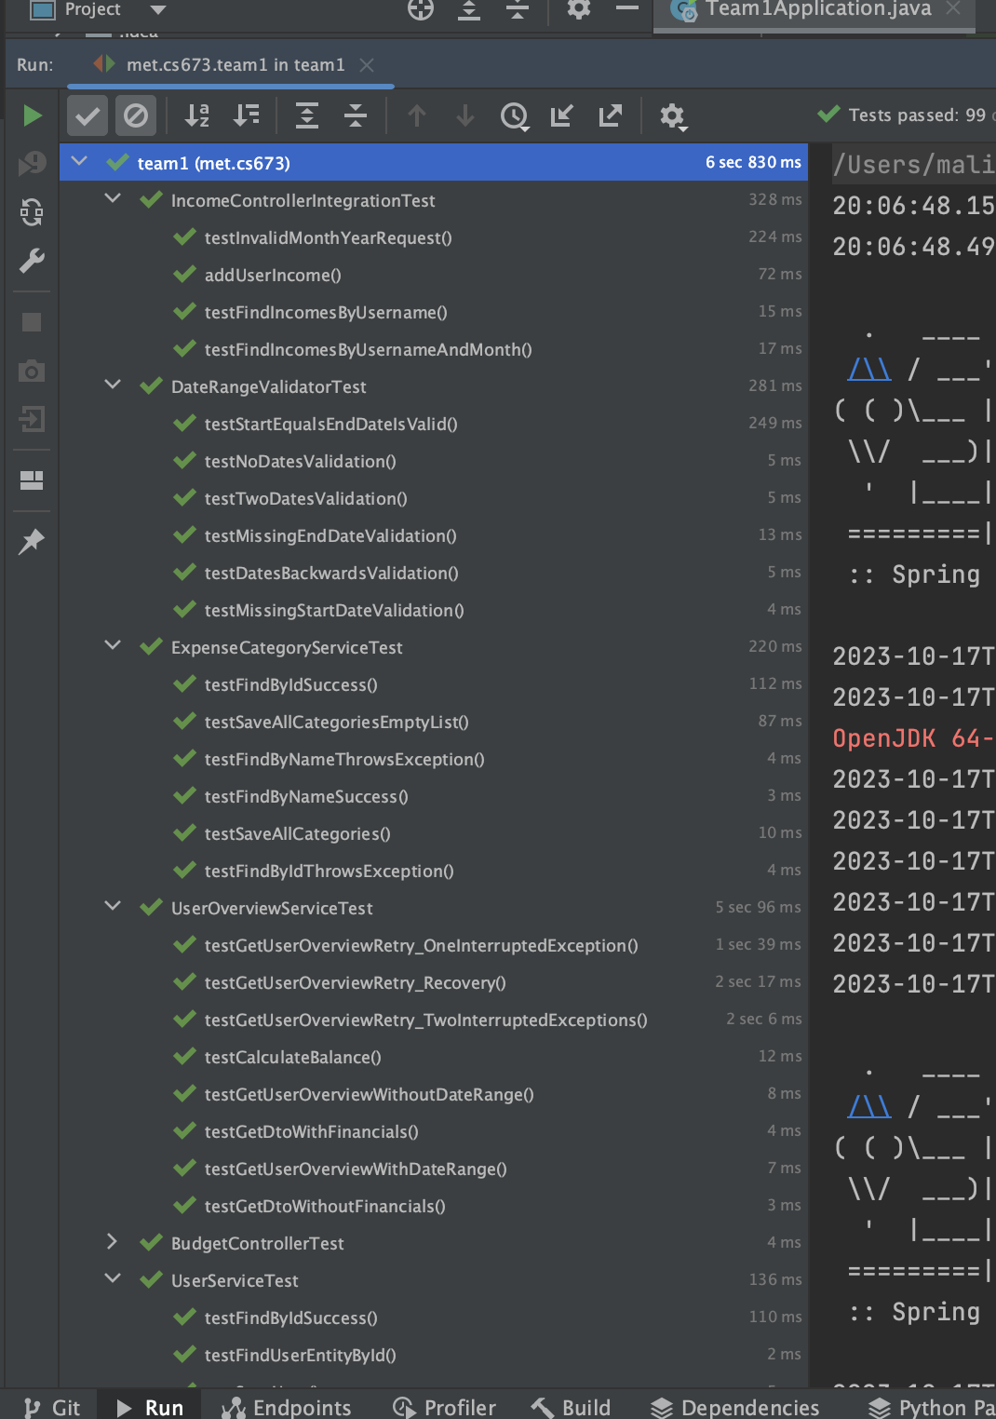
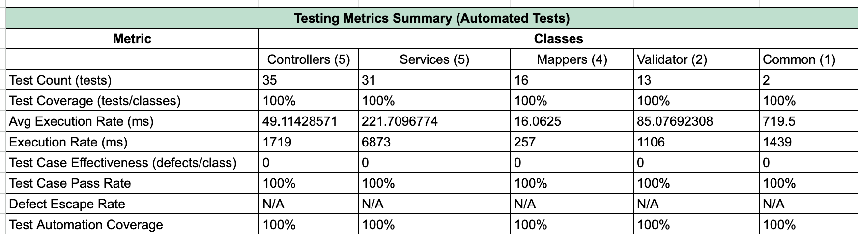
Testing Report
Notes:
Here’s our Testing Metrics Report. We’ve have 99/99 automated tests passing.
The metrics report breaks down the tests by class type. So here we have metrics for our different Controller, Service, Mapper, Validator, and Common classes.
We have tests covering 100% of all classes and methods.
On the right we a screenshot of our generated Testing Report

Slide 18
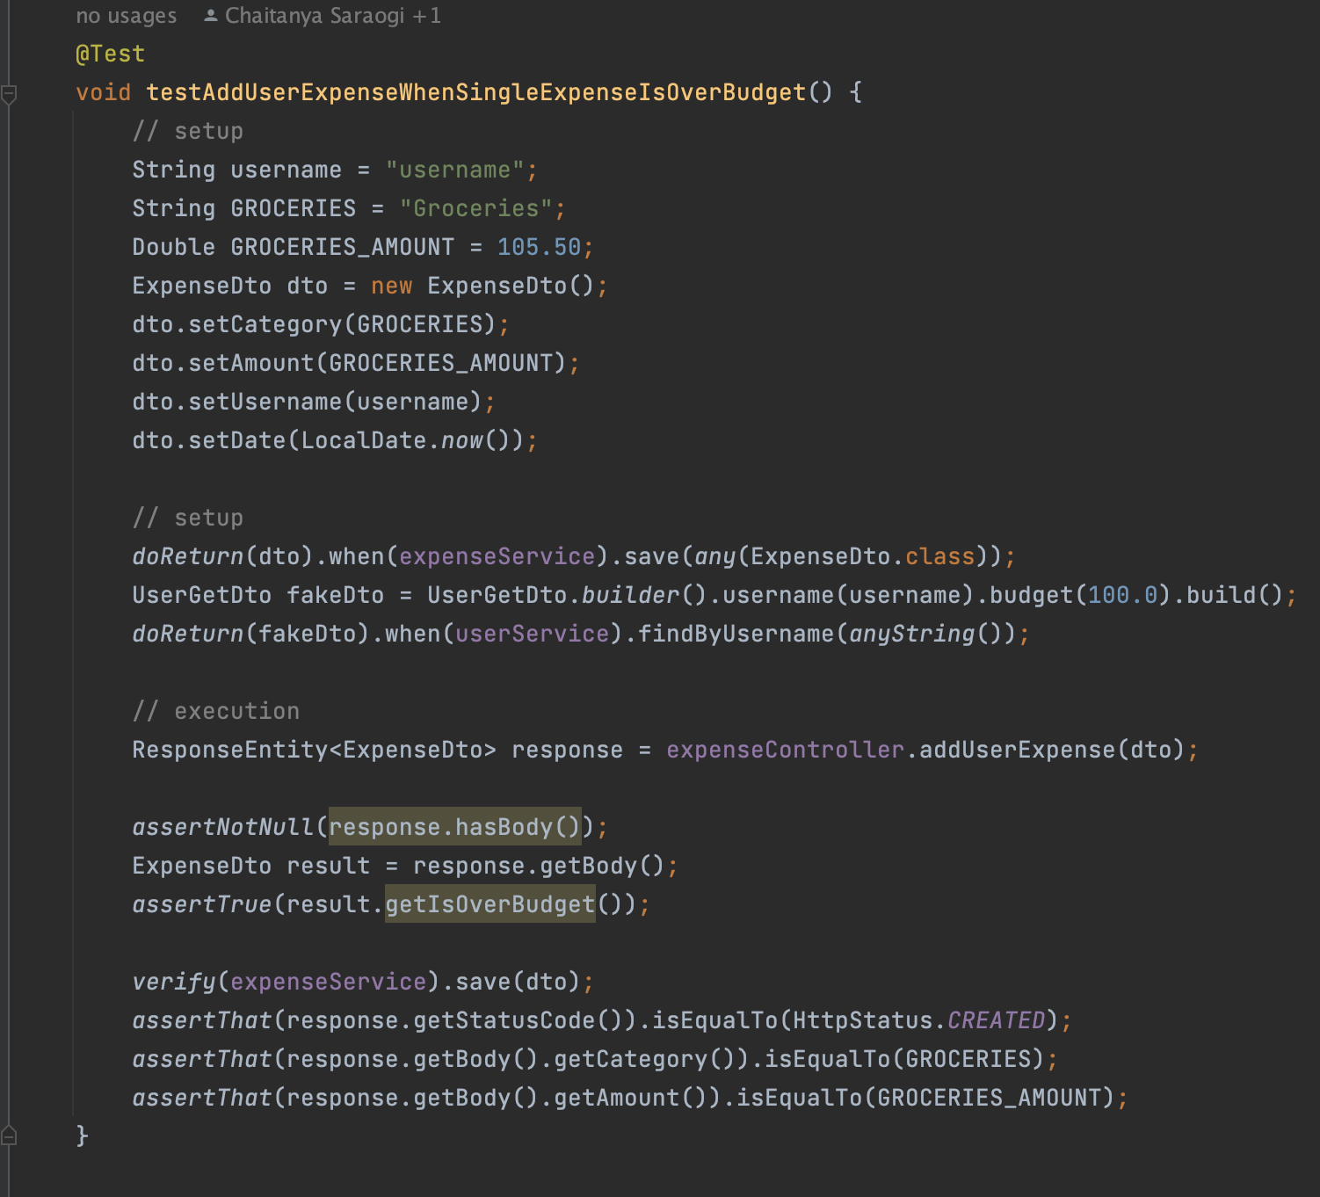
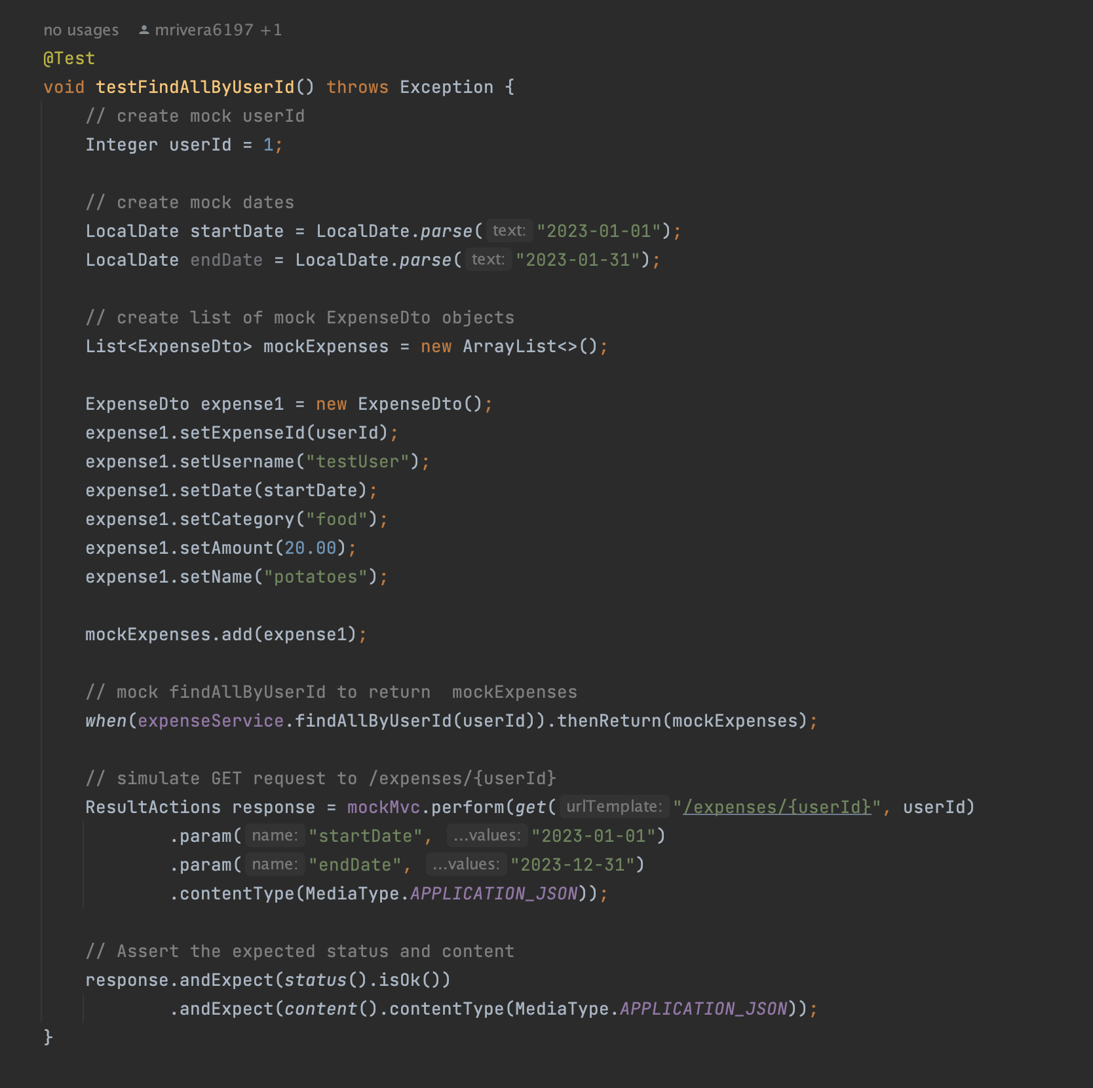
Testing Examples
Notes:
Here are a couple testing examples, on the left, is an example of an Integration test, that tests the “/expenses/{userId}” endpoint of the Expense Controller. This was written with Junit mockito and mockMVC
In this test, a mock list of expenses and a mock userId are created. The expenseService findAllByUserId method is mocked to return the mock expenses. And then a GET request to “/expenses/{userId}” endpoint is simulated with userId, startDate, and endDate as parameters.
The test then asserts that the response is 200, Ok.

Slide 19
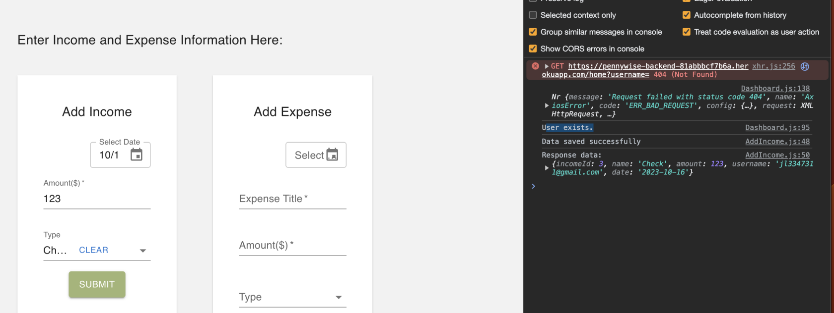
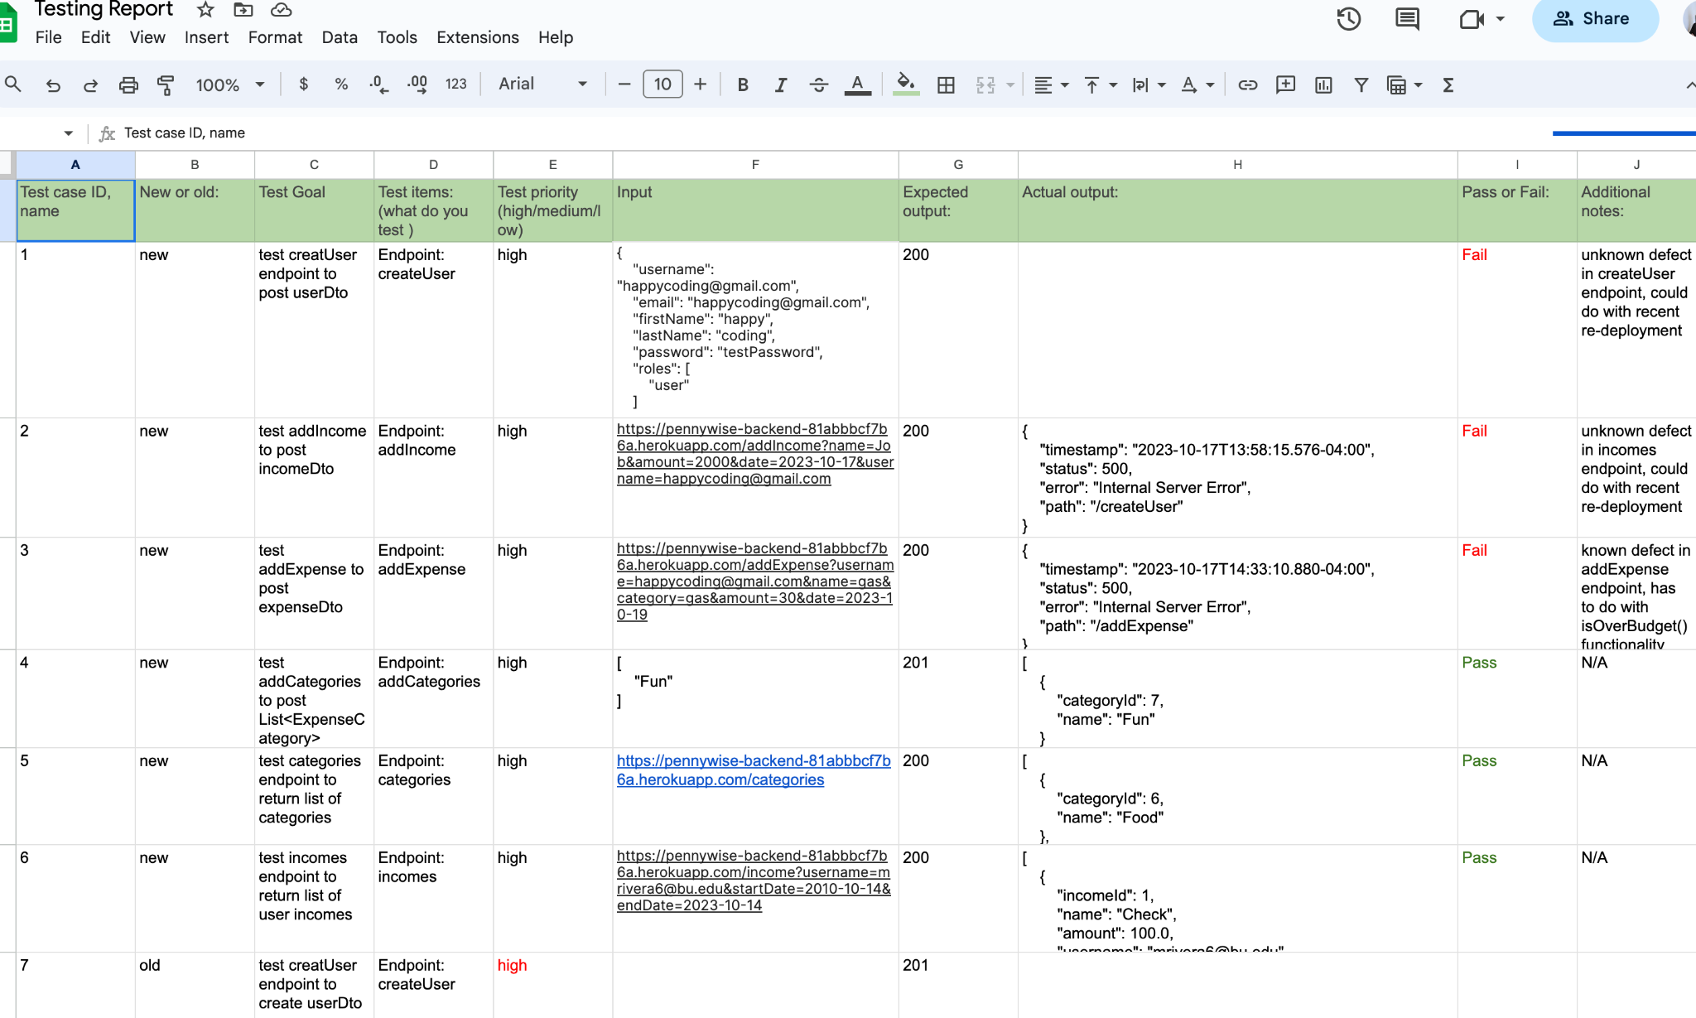
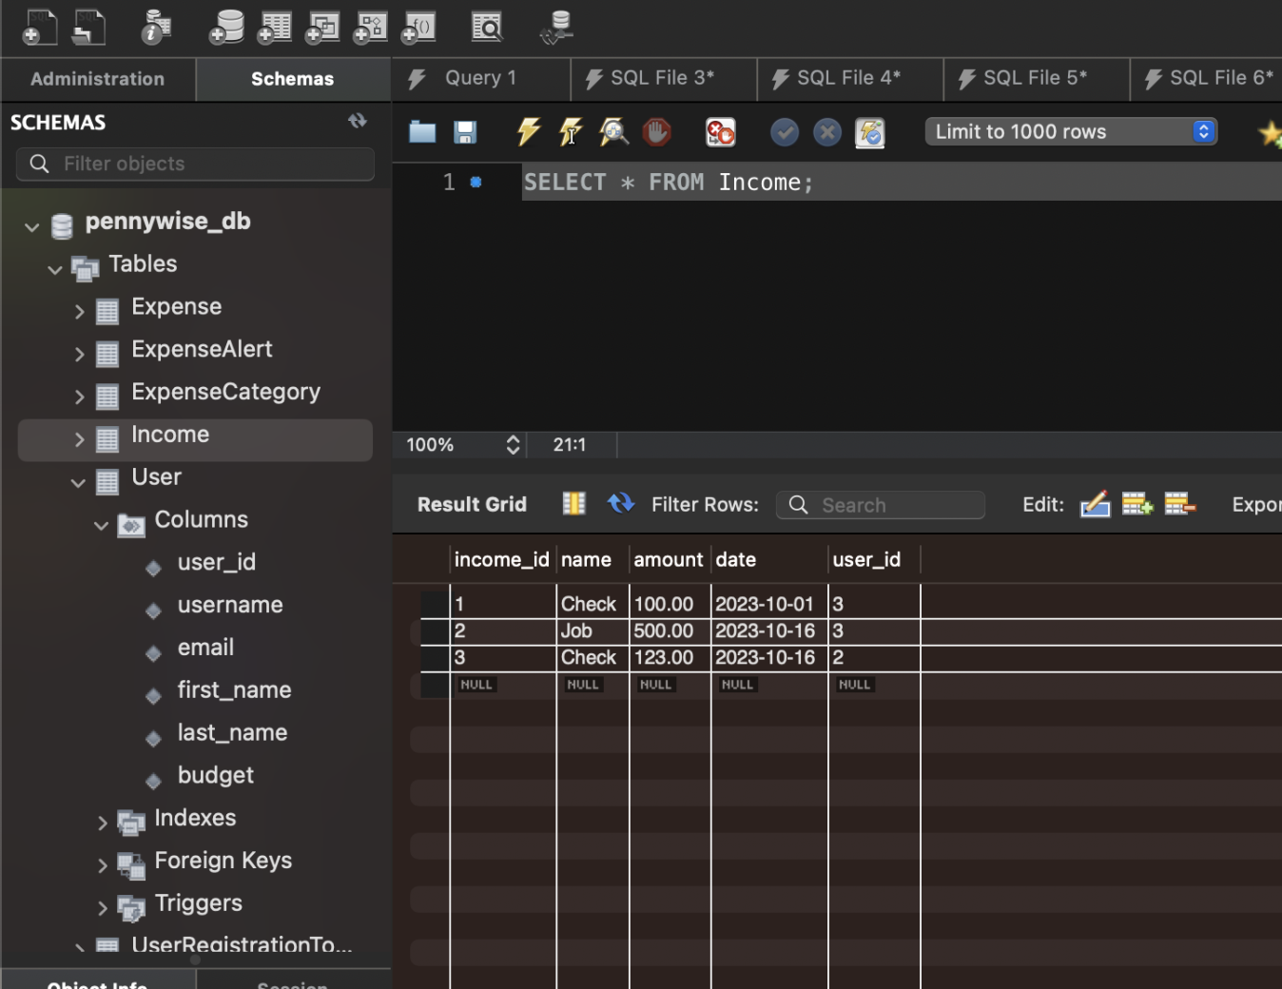
Manual Tests
Notes:
In addition to our automated tests, we completed a number of manual tests throughout the course of development. Our manual tests were either completed with Postman or with our User Interface. On the left, is our Manual Testing Report of API calls with Postman. And on the right is an example of a manual test with our User Interface. Here a developer is first inputting income data to the Add Income form and then hitting subit. The developer then checks the browser console for success or failure messages and also checks the DB to see that the information was successfully saved.
We originally hoped to implement acceptance test with cucumber, although given the timeframe and our priorities we focused on unit and integration testing.

Slide 20
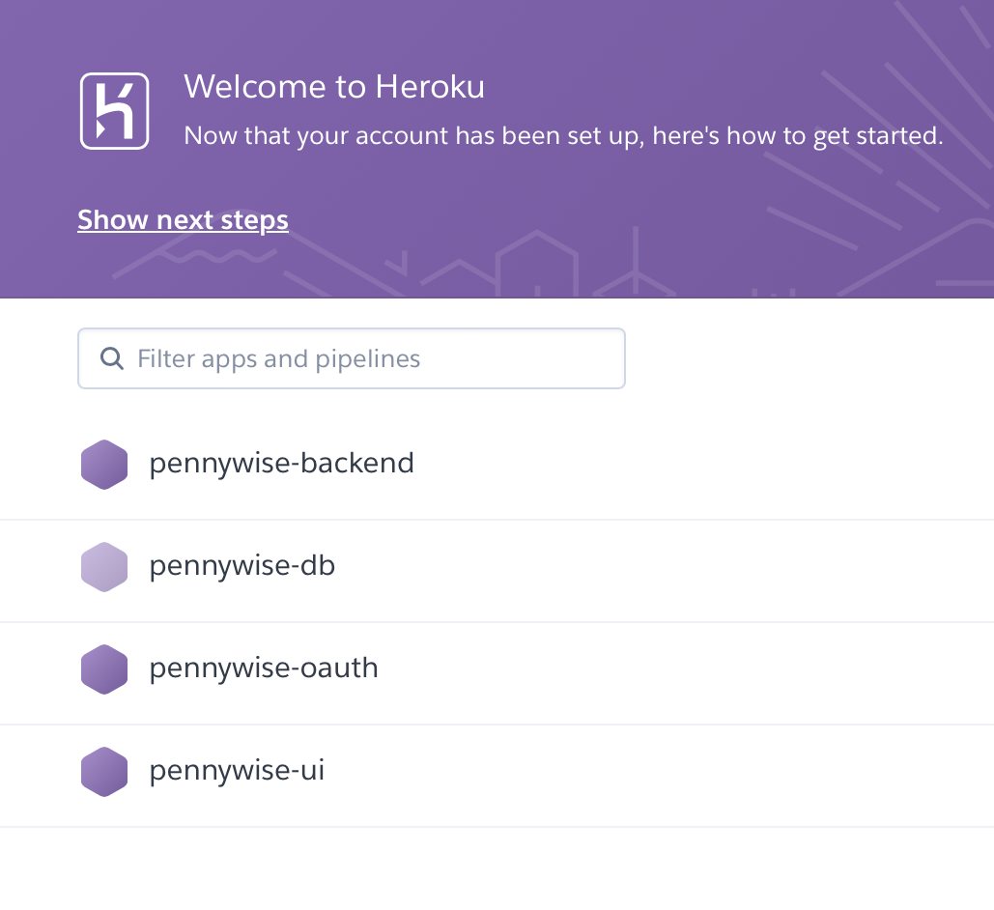
Deployment Overview
Heroku and Dynos
Database
Backend
Frontend
OAuth

Slide 21
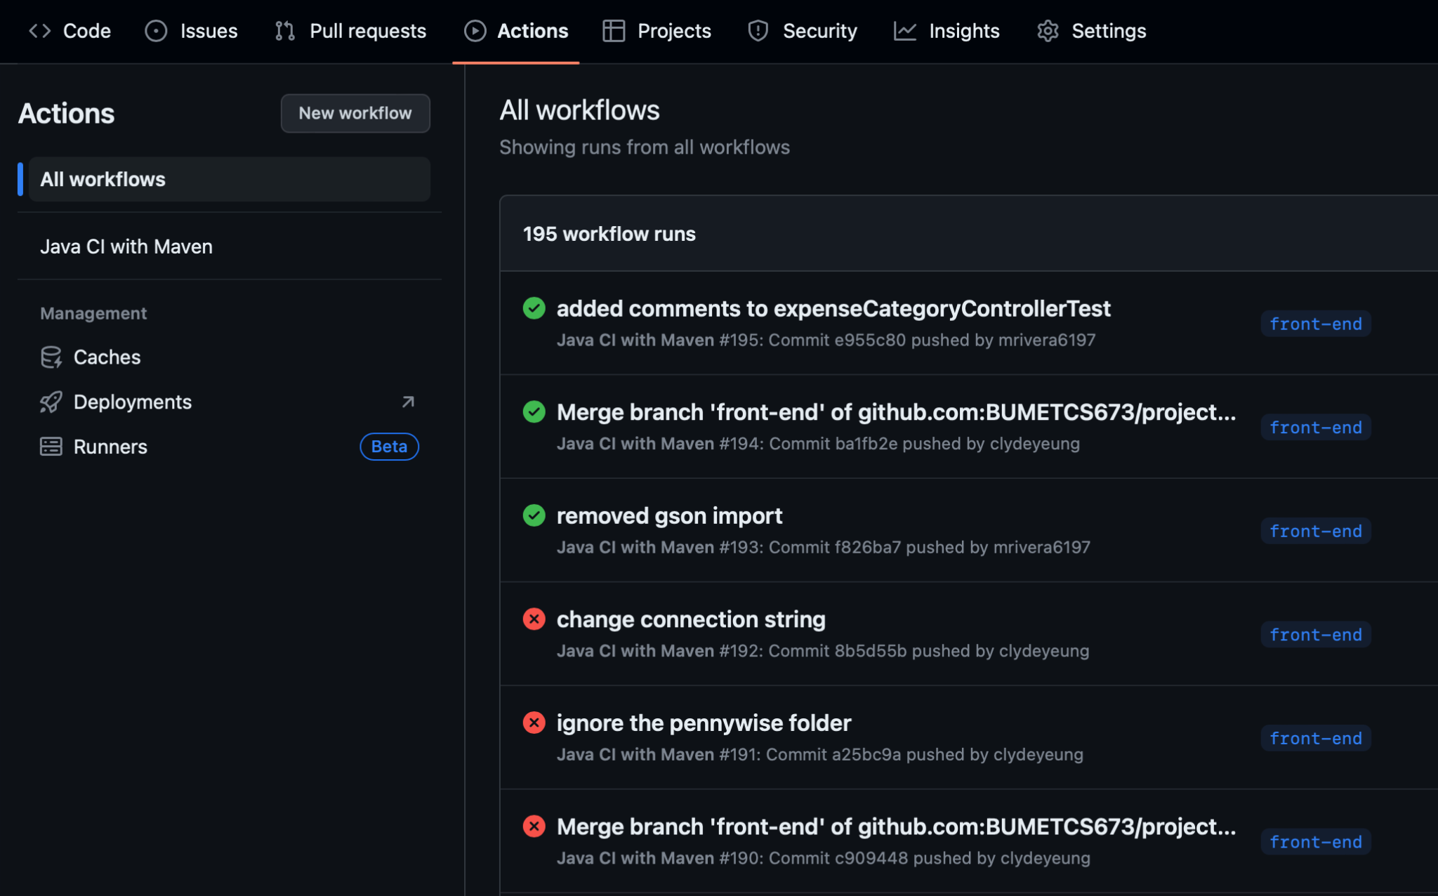
Deployment Cont.
GitHub Action
Triggered on Push/PR
Multiple Branches
Notes:
Clyde

Slide 22
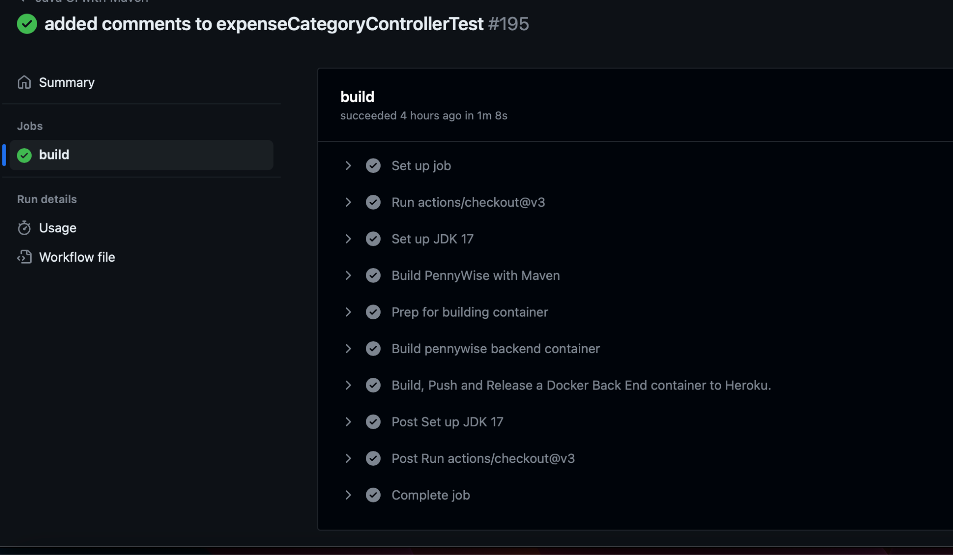
Deployment Cont.
Workflow Process:
Move to the left:
Notes:
Clyde

Slide 23
Project Management
Overall Team Contributions:
User Story creation
Acceptance test creation
Refactoring of bad code smells
Brief overview of individual contributions:
A more detailed description of individual contributions can be found in the Progress Report document.
Chaitanya
Design Pattern for SDD
Budget Notification System Backend
Unit testing
Sean
Endpoint creation
Unit testing
Documentation Updates
Clyde
Overall tools setup, containers configuration
Heroku/Deployment setup + troubleshooting
Setup/Deploy Pipeline, manual testing
Mali
Consistent testing for each iteration
Frontend components build
Authentication testing + troubleshooting
Notes:
Brian

Slide 24
Project Management Cont.
Brief overview of individual contributions (cont.):
A more detailed description of individual contributions can be found in the Progress Report document.
Sherif
Google Oauth Lead
Class Diagram creation
Endpoint creation
Brian
Frontend components build
UI Prototype creation
Jisoo
Frontend Authentication setup/troubleshooting
Endpoint testing with backend team
Consistent Jira Updates
Notes:
Brian

Slide 25
Project Management Cont.
Risk Management:
** Key areas, more information can be found in our SPPP Risk Management document **
Integration & Deployment
Design & Implementation
Achievements of the Project:
End product has met the core requirements outlined at the start of class
Everyone has learned at least one new program/tool for development
Better overall understanding of deployment, frontend vs. backend requirements, security and authentication requirements and difficulties
Challenges of the Project:
Time management
Lots to accomplish in a very tight timeline
Managing scope creep
Easy to be tempted to add things in supplementally while working through the project
Notes:
Brian

Slide 26
Project Management Cont.
Lessons Learned:
Plan for the end and then move backwards
Predefined Tool expectations
Notes:
Since a lot of different deployment and authentication tools have other tools that they work best with, it could be beneficial to look through those end items a bit at the beginning in order to better set up your code to align with those tools at the end.
Having such an open ended project can make it difficult to select all of the tools needed to get started so having some of those predefined like you would likely find in a workplace would be helpful for the initial progress of the project

Slide 27
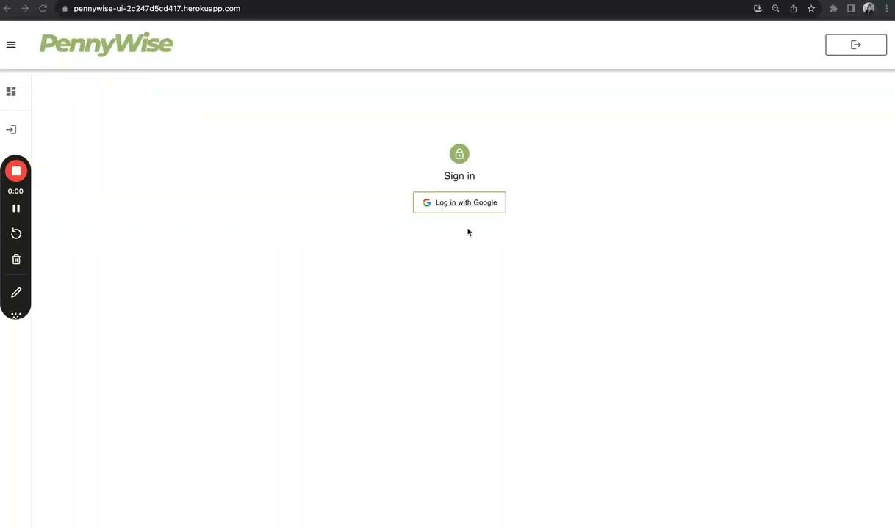
Demo

